Slide 1
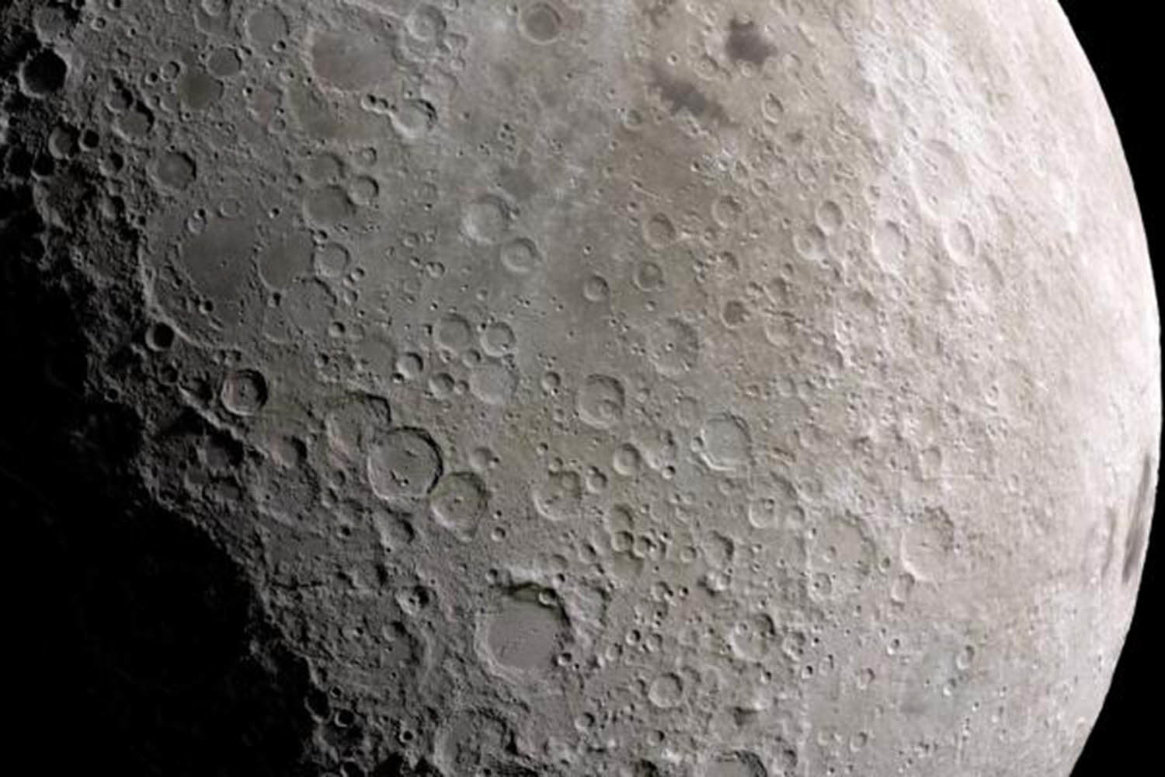
Finding how long it takes for a surface to reach crater equilibrium using a CTEM simulation
Crater Equilibrium
Vinith Thangaraj
May 3, 2019

Slide 2
Background Information
Crater Equilibrium – when the addition of one new crater of a specific size causes around one crater of the same size to be erased (Minton and Fasset, 2016)
Crater Counting – technique that can be used to find the age of a surface
Assumption 1: When surface was new, there were no impact craters
Assumption 2: All craters formed since formation of surface are included in statistics

Slide 3
What is being done?
Find if heavily cratered surfaces such as those of the Moon and Mercury have reached saturation equilibrium
Create a simulation to model the impact of craters over a long period of time
Use the simulation to find how long specific surfaces will take to reach saturation equilibrium
Potentially find out how to get around saturation equilibrium to measure age of a surface

Slide 4
Why is this important?
Only other major way to measure age of the Moon is radiometric dating
Very costly to get samples and samples are limited
Crater equilibrium breaks the second assumption of crater counting
Not all craters are accounted for in statistics
Craters that reach crater equilibrium are unreliable for calculating the age of a surface

Slide 5
Already known information and new information
Known
How to calculate saturation equilibrium
Which surfaces have achieved saturation equilibrium on the Moon (not all)
How to create simulation modeling impacts of craters
New
How long it takes for surface to achieve saturation equilibrium
How to get around saturation equilibrium when measuring age of a surface using crater statistics

Slide 6
How is this going to be done?
Use images of the planets combined with crater statistics for saturation equilibrium of Moon and Mercury
The simulation
A Cratered Terrain Evolution Model (CTEM) that uses Monte Carlo techniques
Takes in values for size frequency distribution of the impactor population and returns impactor size, depth, and ejecta
Potential way to measure age after equilibrium
Find pattern in ejecta of craters
Very recent Minton article (Judy, 2019)

Slide 7
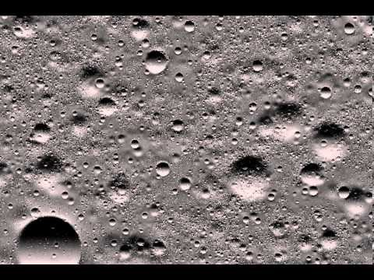
Video of Similar Simulation
Seismic Shaking Crater Erasure on the Surface of the Moon
https://www.youtube.com/watch?v=wLLkyRzgauk&list=PLIH3HtUju_3EVUFR3JR8Ba750lJnKgqNZ&index=1

Slide 8
References
Minton, D. A., and C. I. Fassett (2016), Crater equilibrium as an anomalous diffusion process, Lunar Planet. Sci. Conf., 47, 2623.
Judy, L. (2019, April 8). EAPS Study Identifies Source of 'Crater Equilibrium'. Retrieved from https://www.eaps.purdue.edu/news/articles/2019/minton-crater.html

